Slide 1
Why we need a pet?

Slide 2
woof!

Slide 3
1
3
2
4
10 Reasons Why You Need a Dog in Your Life!
1
3
5
2
4
10
6
8
7
9

Slide 4
1
Dogs increase your mood dramatically!

Slide 5
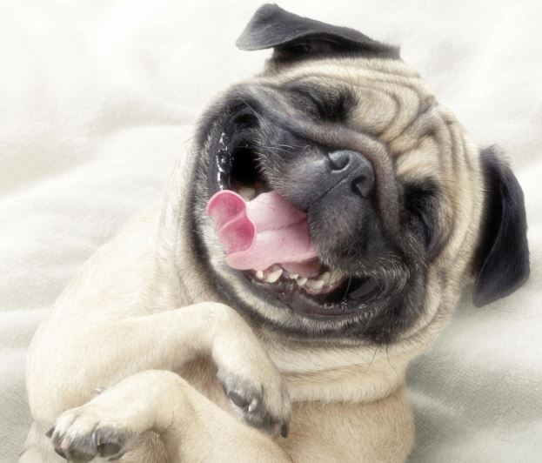
Spending just 15-30 minutes with your dog can help you feel more calm and relaxed, reducing stress and increasing happiness.
Playing with your pup increases your brain’s levels of dopamine and serotonin, both of which are neurotransmitters associated with pleasure.
So the next time you’re feeling down, grab a toy and spend some time with your pup! That wagging tail will be sure to put a smile on your face.

Slide 6
2
Humans with dogs recover more quickly from illnesses.!

Slide 7
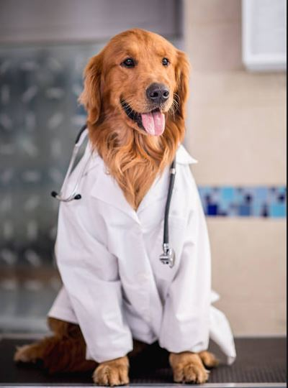
Dog owners have a much higher rate of recovery from being sick than non-dog owners.
In fact, humans with pooches who suffer from heart attacks are twice as likely to fully recover as those without!
So start cuddling your dog!

Slide 8
3
Having a dog improves your physical well-being and encourages a healthy fitness.!

Slide 9
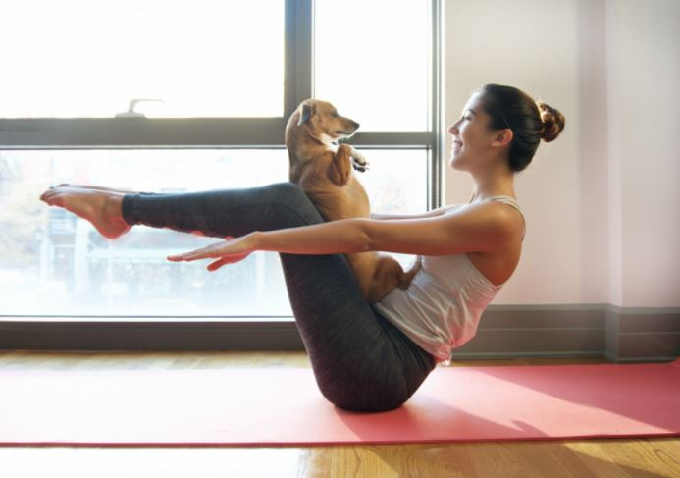
Of course! Your dog requires daily exercise, and so do you!
Dog owners carry the responsibility of playing with and working their dogs, so it only makes sense that dog people tend to be more active.

Slide 10
4
Dogs help increase social interactions!

Slide 11
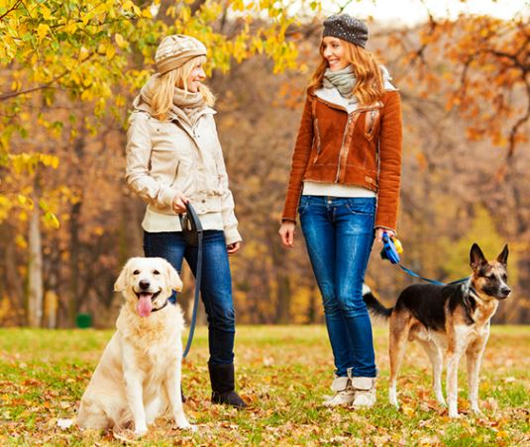
Not only do dogs need care and playtime with their humans, but they need time to socialise with other pups too!
This means that their humans will have a chance to socialise while they oversee the puppy playdates.
Even going on a walk in the neighborhood can bring many new friends around and start many conversations!

Slide 12
5
Having a dog makes YOU more awesome!!

Slide 13
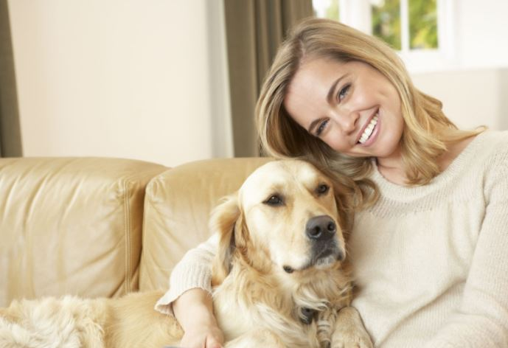
The responsibility, patience, selflessness, and commitment that come with having a dog make us stronger, all-around better people.

Slide 14
6
Owning a dog could make you more attractive to potential love matches!

Slide 15
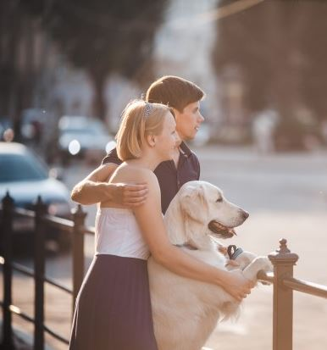
According to a study conducted by Dog’s Trust, out of 700 surveyed people, 60 percent said that owning a dog can make others more attractive, while 85 percent think people are more approachable when they are with a dog.

Slide 16
7
Because they live to protect their little mates!

Slide 17
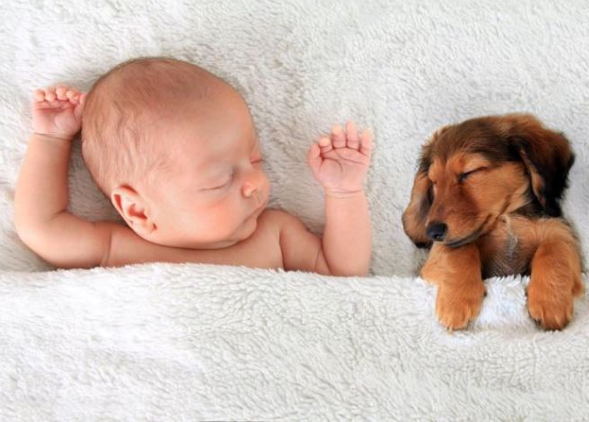
And children can learn a lot of their fur friends! Remembering to feed, provide water, and clean up after a dog can give children a sense of importance and satisfaction.
Dogs also teach children about socialisation. Like most of us, dogs are social animals who enjoy and need attention and affection. By learning how to interact with a dog, children can learn how to better socialise with new faces and other children.

Slide 18
8
Because they give the best kisses!

Slide 19
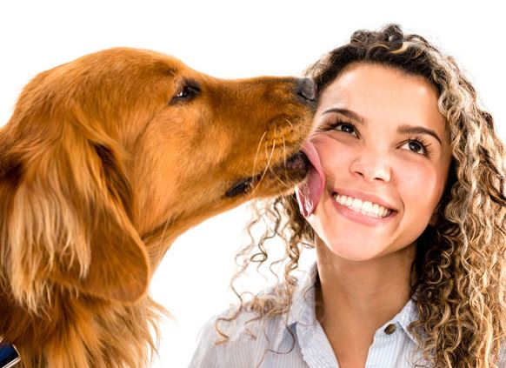
Cold and damp… But still so cute!
Your dog licking your face is a sign of affection and respect.
Pups also use licking when curious about how you are feeling.
By licking your face, your dog may be able to determine whether you are happy or feeling stressed.
The act of licking also releases pleasurable endorphins in dogs and often gives them a sense of comfort and security. Your dog may lick your face simply because it feels good
(and we like it too)!

Slide 20
9
They are a reflection of your personality!

Slide 21
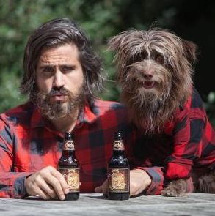
The kind of dog you have tells people a lot about your personality. A study in England found a very clear correlation between people’s personalities and what type of dogs they owned.
For example, people who owned toy dogs tended to be more intelligent, while owners of utility dogs like Dalmatians and bulldogs were the most conscientious. But be careful: Dogs also take on their owners’ personality traits, so if you fly off the handle all the time, your pooch may wind up with aggressive tendencies.

Slide 22
10
Do we need to say more?!

Slide 23
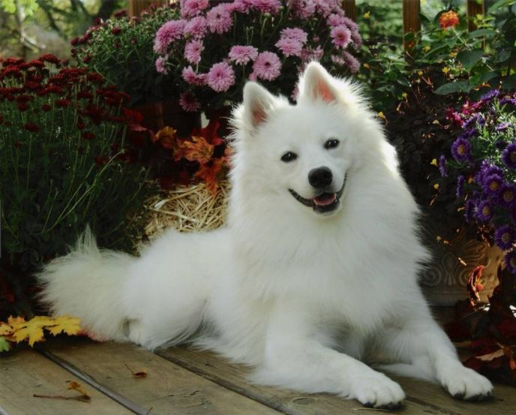
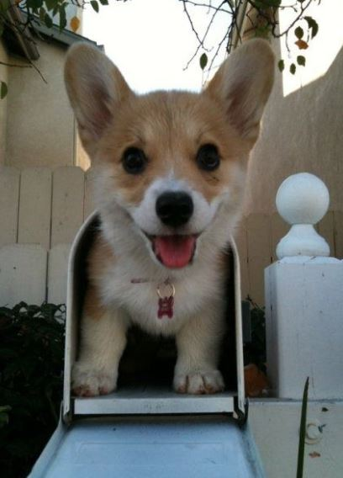


Slide 24
40,000,000
Population of dogs in the World

Slide 25
where DO they live?

Slide 26
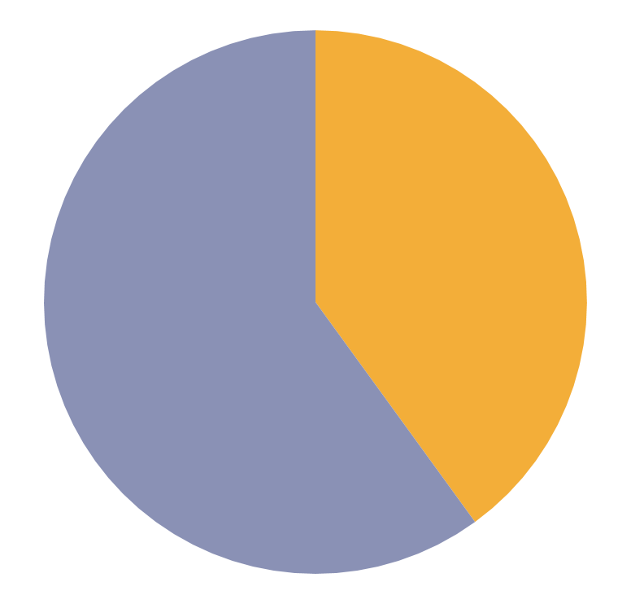
dogs vs cats
40%
60%
dogs
cats

Slide 27
THERE ARE 800 Types of dogs

Slide 28
doggy infographic
needs
walks
80%
THEY SPEND TIME WITH US

Slide 29
words to describe them
25%
25%
50%

Slide 30
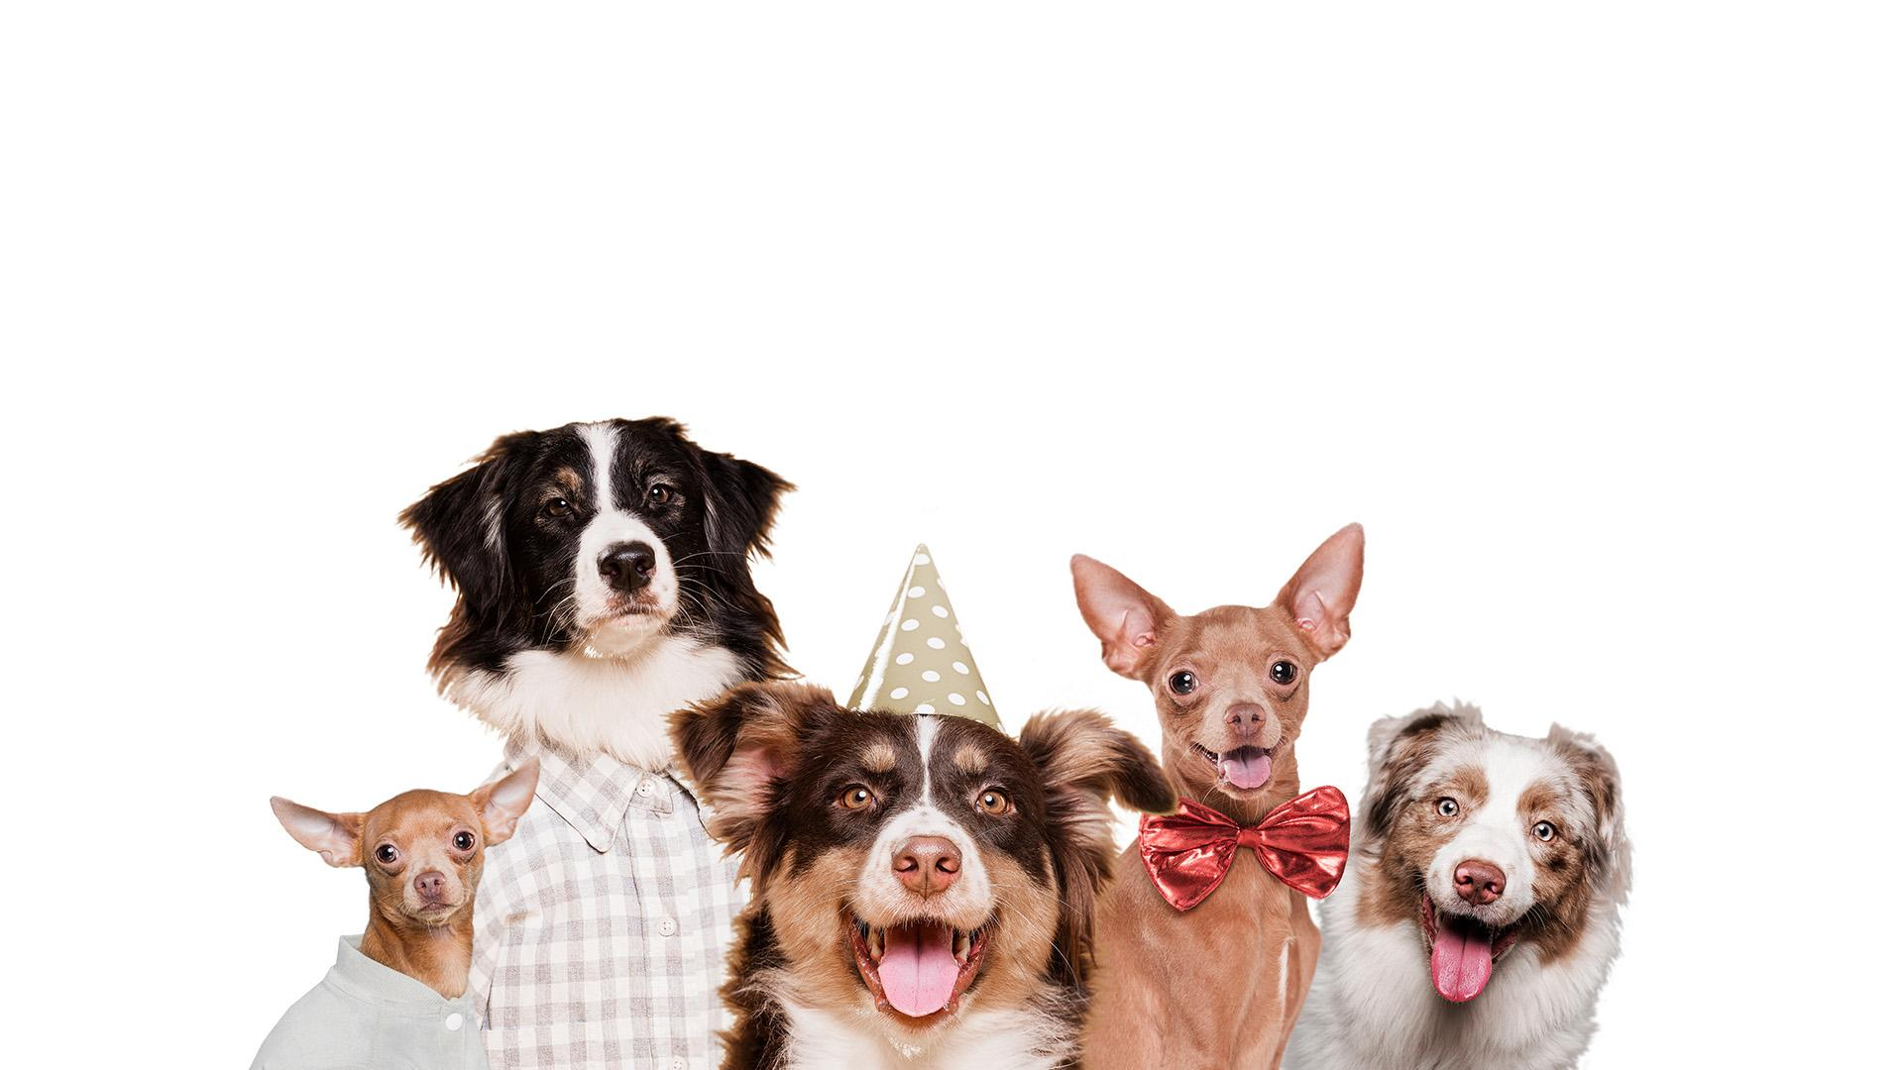
a picture is worth
a thousand
words

Slide 31
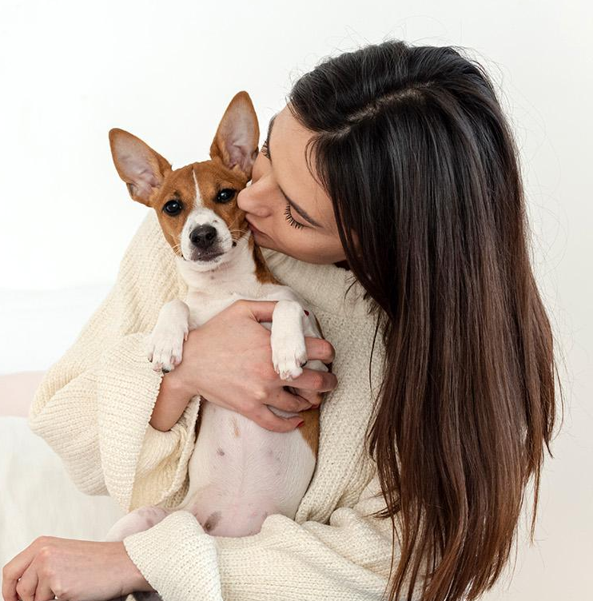
THEY ONLY HAVE US

Slide 32
THANK YOU FOR WACHING

